Slide 1

A framework for Directed Test Generation and Validation for Cache Coherence Protocol Implementations
Abhinaba Chakraborty
Indian Statistical Institute, Kolkata
Master's thesis presentation

Slide 2
Outline
Introduction
Background and Related Work
Verifying Cache Coherence Protocols in Single Level Cache Hierarchy
Verifying Cache Coherence Protocols in Multi Level Hierarchy
Conclusions & Future Work

Slide 3
Cache
Main Memory is slow
2. Caches are smaller but faster than main memory
3. Use the concept of Temporal Locality and Spatial Locality
4. Instruction and Data caches have contributed significantly to enhancing execution speed

Slide 4
Multi Core Processors
Modern processors have multiple cores
2. Can have 4, 8, 16, 32 cores
3. Each core has its own private cache
4. At the last level, we have a shared memory (main memory)
Core n
Core 1
5. Enhanced concurrency, useful for simultaneous thread
execution / parallel workloads – different threads executing
on different cores sharing a set of common variables
Cache Controller
Private Data Cache
Cache Controller
Private Data Cache
Last Level Cache/Memory Controller
Last Level Cache
Main Memory

Slide 5
Cache coherence in Multicore processors
Core 1
Core 2
Load r1, mem[A]
Load r1, mem[A]
L1 Cache
L1 Cache
A
42
A
42
A
43
Add r1, r1, #1
Store r1, mem[A]
Single Write, Multiple Read (SWMR) Invariant
To prevent this inconsistency, we need to ensure the SWMR invariant,
The value of the given memory location should be propagated correctly
Data Value Invariant

Slide 6
Cache Coherence Protocols
Set of rules that define the behavior of the cache controller upon receiving a request from a core.
2. This behavior can be represented by an FSM for each memory block for each cache.
Invalidations or Replacements
I
S
Invalidations or Replacements
Self Load
I
S
Self Load
Self Store
Invalidations or Replacements
Self Store
Other Read
FSM of Cache Controller for SI Protocol:
1. S (Shared) : One or more core is reading the block.
2. I (Invalid) : Core is reading the block.
M
FSM of Cache Controller for MSI Protocol:
S (shared) : One or more core is sharing the block.
I (Invalid) : No core is sharing the block
M (Modified): Only one core is writing to the block
Notes:
i

Slide 7
Validation of Cache Coherence Protocol implementations
Cache Coherence Protocol is indispensable for concurrent multi-core programs
  Ensures Cache Consistency
Ensuring correct implementation of cache coherence is important
  Bugs in the cache controller coherence logic can lead to incorrect outcomes
  Concurrency bugs are hard to debug and fix
  Necessitates a thorough validation process
Validation needs to ensure the following:
  Examine all multi-core configurations - sequence of loads and stores in different order across multiple cores
  Cover all states and transitions of the cache controller FSM for a block to ensure that all types of transactions are examined
  Scale to large number of cores

Slide 8
Outline
Introduction
Related Works
Verifying Cache Coherence Protocols in Single Level Cache Hierarchy
Verifying Cache Coherence Protocols in Multi Level Hierarchy
Conclusions & Future Work

Slide 9
Cache coherence verification: Related work
Exponential Increase in Space
Limits the applicability on actual Implementation
Formal Verification
  Explicit State Analysis by Dill et al ICCD 1992
  BDD Based Methods
Randomness
Difficulty to reach coverage goal
Simulation Based Approaches
  Random Tests, Wood et al, IEEE D&T 1990
  Template Based Adir et al, IEEE D&T 2004
Too many redundant tests generated
The framework does not consider a multi-level cache hierarchy
Directed Test Generation [1]
  Most promising outcome
  Prabhat Mishra et al, TCAD 2018
We develop a Directed Test Generation framework that can reduce the number of tests
Our method can cater to the needs for a multi level cache hierarchy

Slide 10
Outline
Introduction
Related Work
Verifying Cache Coherence Protocols in Single Level Cache Hierarchy
Verifying Cache Coherence Protocols in Multi Level Hierarchy
Conclusions & Future Work

Slide 11
Our contributions
A framework for cache coherence verification for a single level cache
A framework for cache coherence verification for a multi-level cache
Integration within the test generation framework at IMEC
Experimental Results

Slide 12
Why Directed Tests?
A
A
B
B
Activate the desired behavior with small number of tests
Random Tests
Directed Tests

Slide 13
Directed Tests for SI cache coherence
For a cache block, each cache controller inside each core keeps a 2-state (S and I) FSM
Global FSM is obtained by composing the core-level FSMs – a HyperCube, each state corresponds to an n-bit vector denoting the state of the block in each core
ISI
ISS
III
IIS
Example with n = 3
Note: each transition changes the state of only ONE core
SSI
SSS
SII
SIS
The number of states in the state space of SI is 2^{n}
The number of transitions is n2^{n}

Slide 14
Directed Tests for SI cache coherence
Need to validate all possible configurations and interleaves of reads and writes / evictions
Need to consider the states and transitions of the composed FSM
Each request issued by a core, at least one transition in the Hypercube is covered
Need to generate tests to cover ALL states and transitions of the global Hypercube– Our goal
ISS
Core 1
Core 2
Core 3
IIS
ISI
Evict
Evict
Evict
III
Read
Read
Read
S
I
S
I
S
I
SSS
SIS
SSI
SII

Slide 15
Directed Test Generation for SI: Approach
GOAL:
  Cover all states and transitions
Transitions close to initial states are repeated
To avoid repetition, we need exponential space.
Generate one test to activate each state
Perform BFS on global FSM to reach it
Once we reach a state, append required instructions to activate the associate transitions
Prabhat Mishra et al addresses the above issues
Too many tests generated
Our approach reduces the number of tests to almost half keeping the goal intact

Slide 16
From n-Hypercube to n-trees
The n-hypercube can be decomposed into n isomorphic trees
Can apply Euler tour on those trees
Total number of tests: n2^{n}
ISS
ISS
IIS
ISI
III
III
III
For n = 3
SSS
SSS
SSS
SIS
SIS
SSI
SSI
SII

Slide 17
Test generated for 3 cores
Load 0
2. Load 1
3. Evict 1
ISI
ISS
4. Load 2
5. Load 1
III
6. Evict 1
IIS
Note: EVICT => cache block is invalidated from the core
For this, another memory block mapping to the same cache line is loaded
7. Evict 2
8. Evict 0
….
SSI
SSS
SII
SIS

Slide 18
Our Motivation
Test Cases for 3 cores P0, P1, P2
P2 : Load B0
B0
B1
III
IIS
III
ISI
2. P1 : Load B0
3. P1 : Load B1 (Evict B0 from P1)
4. P0 : Load B0
5. P1 : Load B0 (Evict B1 from P1)
SIS
6. P1 : Load B1 (Evict B0 from P1)
ISS
SSI
7. P0 : Load B1 (Evict B0 from P0)
8. P2 : Load B1 (Evict B0 from P2)
SSS
SSS
Some test sequences cover two transitions in one go
=> Consider two cache blocks B0 and B1 that map to the same line
=> No need to generate one test per transition!!
Takeaway:
  Choose 2 blocks carefully
  Track the states and transitions for multiple blocks simultaneously

Slide 19
Our Approach for SI
3 cores P0, P2 and P2
Assumption: All the cores are initially in "I" state for B0, but in "S" for B1
B0
B1
2. Issue P2: LOAD B0
III
IIS
SSS
SSI
ONE instruction helps to cover TWO transitions of the global n-hypercube
Co-ordinated traversal of the two components by the different cores – ensures all states and transitions of the global FSM of a block are covered

Slide 20
Our Approach for SI Protocol
function 𝑠𝑖_𝑡𝑒𝑠𝑡(𝑛)
if 𝑛 ≤ 2 then
for 𝑖 = 0 to 𝑛 − 1 do
{visitHypercubeUtil (𝑛, 𝑖, 𝑛)}
end for
𝑟𝑒𝑡𝑢𝑟𝑛
end if
for 𝑖 = 0 to 𝑛 − 1 do
{Load B1 block by i^{th} core}
end for
for 𝑖 = 0 to 𝑛 − 3 do
{visitHypercubeUtil(𝑛 − 2, 𝑖, 𝑛 − 2)}
end for
_ visitHypercubeUtil (𝑛 − 2)
𝐿𝑂𝐴𝐷 (𝑛 − 1, 0)
for 𝑖 = 0 to 𝑛 − 3 do
{visitHypercubeUtil (𝑛 − 2, 𝑖, 𝑛 − 2)}
end for
end function
Step 1: Divide the n-hypercube into two isomorphic components intelligently
Note: the states and transitions of the two parts are complementary => if we issue a test for one block that covers one state in one component for one block by one core, a corresponding state in another block is covered by another core
Step 2: Issue tests with an intelligent traversal of each component
ISS
ISS
IIS
ISI
III
III
III
SSS
SSS
SSS
SIS
SIS
SSI
SSI
SII

Slide 21
An example with 4 cores
function 𝑠𝑖_𝑡𝑒𝑠𝑡(𝑛)
if 𝑛 ≤ 2 then
for 𝑖 = 0 to 𝑛 − 1 do
{ visitHypercubeUtil (𝑛, 𝑖, 𝑛) }
end for
𝑟𝑒𝑡𝑢𝑟𝑛
end if
for 𝑖 = 0 to 𝑛 − 1 do
{Load B1 block by i^{th} core}
end for
for 𝑖 = 0 to 𝑛 − 3 do
{ visitHypercubeUtil(𝑛 − 2, 𝑖, 𝑛 − 2) }
end for
{ _visitHypercubeUtil (𝑛 − 2) }
{ Load B0 block by (𝑛 − 1^{)th} }
for 𝑖 = 0 to 𝑛 − 3 do
{ visitHypercubeUtil (𝑛 − 2, 𝑖, 𝑛 − 2) }
end for
end function
SIII
SIIS
n transactions
SSII
SSIS
ISII
ISIS
(n-2)2^{n-2} transactions
IIII
IIIS
2^{n-2}+ 2^{n} transactions
IISI
IISS
1+(n-2)2^{n-2} transactions
ISSI
ISSS
SSSI
SSSS
SISI
SISS

Slide 22
Total Number of Tests issued by us: X = 𝑛 + 𝑛 *2^(𝑛−1) + 2^(𝑛−2) + 1
Total Number of transitions generated by [1]: Y = n* 2^n
For larger n, X/Y = 0.5

Slide 23
MSI
The state space of MSI for 1 block can be modelled as an FSM – 3 states (M, S, I)
2. The global FSM for n cores is the synchronous product of the n block level FSMs
IMI
ISS
ISI
IIM
III
IIS
SSI
SSS
SII
SIS
Some transitions from Shared to Modified states are omitted
MII
3. The number of states in the state space of MSI protocol is n+2^{n}
^{-- Some are invalid}

Slide 24
MESI
An extra E (Exclusive) state is added for MESI to reduce the traffic.
Global FSM has global exclusive states
IMI
IEI
IIM
ISS
ISI
The number of states in the state space of MESI protocol is 2n+2^{n}
III
IIS
IIE
SSI
SSS
SII
SIS
Some transitions from Shared to Modified states are omitted
EII
MII

Slide 25
Our Approach for MSI
IMI
The state space of the MSI protocol can be divided into three parts
A Hypercube
A Clique
Other transitions from S to M states
ISI
ISS
IIM
III
IIS
SSI
SSS
SII
SIS
Our Approach for MESI
MII
The state space of the MESI protocol can also be divided into several parts
A Hypercube
A Clique
Other transitions from S to M
E to S states
E to M states
IMI
IEI
IIM
ISS
ISI
III
IIS
IIE
SSI
SSS
SII
SIS
EII
MII

Slide 26
Outline
Introduction
Related Work
Verifying Cache Coherence Protocols in Single Level Cache Hierarchy
Verifying Cache Coherence Protocols in Multi Level Hierarchy
Conclusions & Future Work

Slide 27
Multi-level caching: How does the directed test work?
Need to consider the states of L1, L2...
Core 1
Core 2
IS, IS
II, II
II, IS
L1 Cache
L1 Cache
SI, SI
SS, SS
SI, SS
L2 Cache
L2 Cache
II, SI
IS, SS
II, SS
State of SI Protocol for L1, L2 inclusive cache
LLC
Main Memory
State Space Explosion: The number of states and the transitions to cover increases exponentially

Slide 28
Multi-level caching: Missing States
For MESI the problem of missing states occurs
Core 0
Core 1
Test Cases
II
P0 : Load B0
EI
L1 Cache
L1 Cache
2. P1 : Load B0
B1
B0
B1
B0
3. P1 : Load B1
4. P0 : Load B1
IS
SS
L2 Cache
L2 Cache
5. P1 : Load B0
B0
B0
B1
B1

Slide 29
Multi-level caching: Missing States
Core 1
Core 2
L1 Cache
L1 Cache
For MESI. some of the global states (IEI, EII) will be missed due to the introduction of L2
L2 Cache
L2 Cache
LLC
Main Memory

Slide 30
Our Approach
1. Choose meaningful states: do not need to cover all states for L1 and L2
Addresses State Space Explosion
2. Pick states considering the coherence protocol and inclusiveness
3. Issue a flush operation for a transition from a state to an invalid state
Solves the Missing State Problem
Proposed Algorithm
function testGenerationMESI :
createTestsSI( )
visitClique( 0 )
visitE( )
visitOtherMESI ( 0 )
visitOtherE( )
end function

Slide 31
Experimental Setup
Used the Structural Simulation Toolkit (SST) for simulation and validation of our proposed approach
SST has built-in MSI and MESI cache coherence modules
Implemented the Directed Testing framework as part of the test infrastructure at the Interuniversity Microelectronics Centre (IMEC), Belgium
  Worldwide popular research centre on Computer Systems Architecture
  Current technology at IMEC: Random tester
Results are promising – significant improvements in performance and bug finding capability

Slide 32
Implementation of Directed Tester
memHierarchyTester by IMEC, Belgium
Tests cache coherence and memory hierarchy
Uses Random Testing Framework
Implemented directed testing framework inside it

Slide 33
Important Results
For SI, reduction of 50% test sequence.
Space Requirement is very low, does not grow much with number of cores
Protocol | 4 Cores | 6 Cores | 8 Cores
SI | 72.25 KB | 72.69 KB | 74.24KB
MSI | 72.15 KB | 72.15 KB | 72.15 KB
MESI | 72.47 KB | 72.85 KB | 74.4 KB

Slide 34
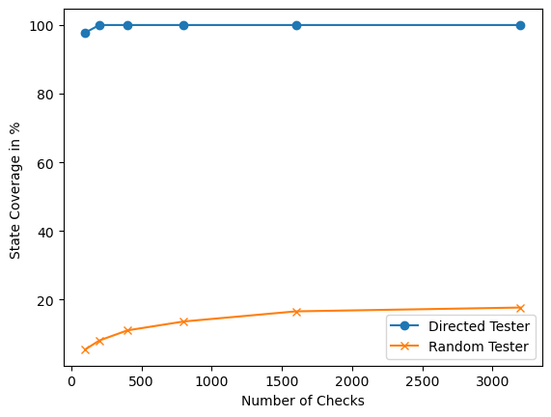
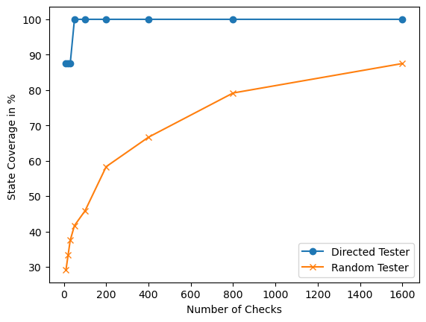
State Coverage
4 Cores
8 Cores

Slide 35
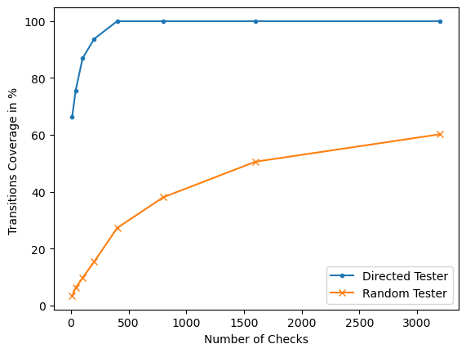
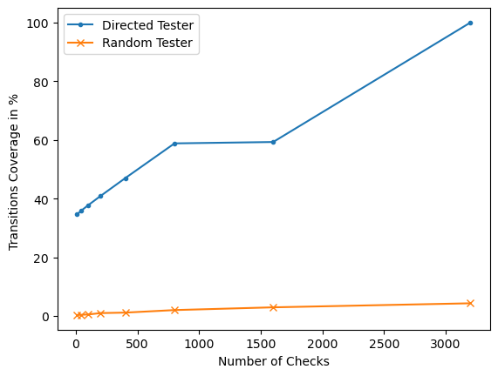
Transition Coverage
4 Cores
8 Cores

Slide 36
Finding Bugs
A well-known bug inside SST memory hierarchy module
Random Tester framework catches bug
  MemHierarchyTester[performCallBack:314]: Action/check failure: proc 1444 at the
  address: 464, byte_number: 0, the expected value is 3f but received 99 instead.
  Time: 6002000
Directed Testing framework was able to catch the bug
  MemHierarchyTester[performCallBack:314]: Action/check failure: proc 47 at the
  address: 0, byte_number: 0, the expected value is 75 but received 5d instead.
  Time: 4373000
Less time, Less checks

Slide 37
Outline
Introduction
Related Work
Motivation
Verifying Cache Coherence Protocols in Single Level Cache Hierarchy
Verifying Cache Coherence Protocols in Multi Level Cache Hierarchy
Conclusions & Future Work

Slide 38
Conclusions
Drastic Reduction in overall validation effort
  50-60% reduction in validation effort
  Faster Coverage convergence
Significant Reduction in Space Requirement
Road ahead:
  Transient states
  Validation of an Internal cache coherence protocol at IMEC
  Moving beyond MESI

Slide 39
References
Lyu, Y., Qin, X, Chen M, and Mishra P, Directed test generation for validation of cache coherence protocols. IEEE Transactions on Computer-Aided Design of Integrated Circuits and Systems 38, 1 (2019), 163-176
Qin, X, and Mishra, P. Automated generation of directed tests for transition coverage in cache coherence protocols. In 2012 Design, Automation Test in Europe Conference Exhibition(2004), vol 1, pp. 182-187 Vol 1

Slide 40
Thank You

